Slide 1




Retail Sales Data Analysis
Data Analysis Using Python,SQL and PowerBI

Slide 2

Step 1: EDA Using Python
EDA stands for Exploratory Data Analysis. It is a key step in the data analysis process, used to understand the structure, quality, and patterns within a dataset before applying modeling or machine learning techniques.
Library used to perform the EDA-Pandas,Matplotlib,Seaborne.
Pandas is a library used to visualize csv files ,SQL tables.
The name "Pandas" comes from "Panel Data", a term used in econometrics.
Built on top of NumPy, it provides high-performance data structures and operations for handling tabular data (like spreadsheets or SQL tables).

Slide 3
Some Functions used in Python Pandas for EDA
pd.read_csv('../retail_data.csv’) –used to read
data.shape-returns shape
data.head()-returns first five rows
data.info()-returns info
data.describe()-returns description
data.isnull().sum()-returns all null values
data.duplicated().sum()-returns all duplicate values
data.nunique()-returns unique values

Slide 4
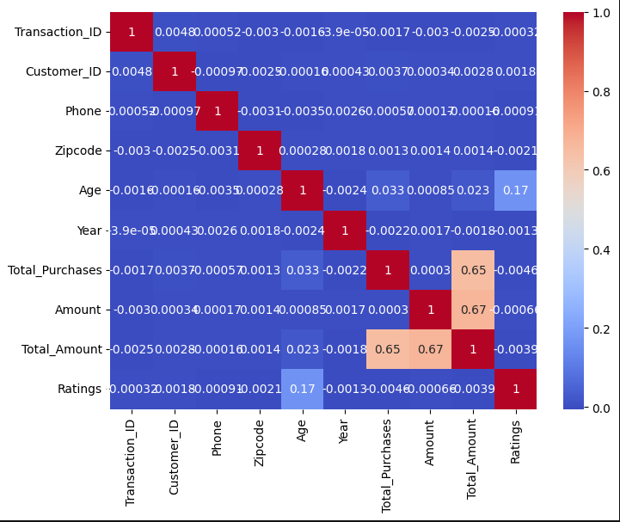
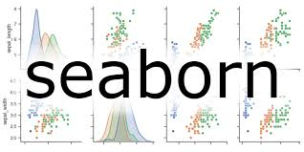
Visualizing Data correlation
plt.figure(figsize=(8,6))
sns.heatmap(data.corr(numeric_only=True),cmap='coolwarm')
plt.show()

Slide 5
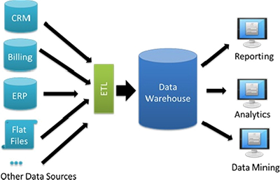
Data Warehousing
A Data Warehouse is a centralized repository that stores large volumes of structured data from different sources, optimized for reporting, analysis, and decision-making.
The Medallion Architecture is a modern data engineering pattern used in data lakehouses (e.g., with Databricks, Delta Lake, or similar platforms). It organizes data into three layers: Bronze, Silver, and Gold—like medals—to improve data quality, scalability, and performance.

Slide 6
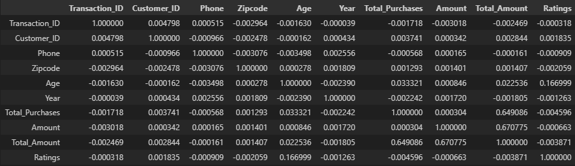
EDA on retail sales data (Some basic points)
Shape of given data-30210 rows , 30 columns
There are 4 duplicated rows
Null values in total- 8370
Unique values-2,008,754
Correlation –

Slide 7
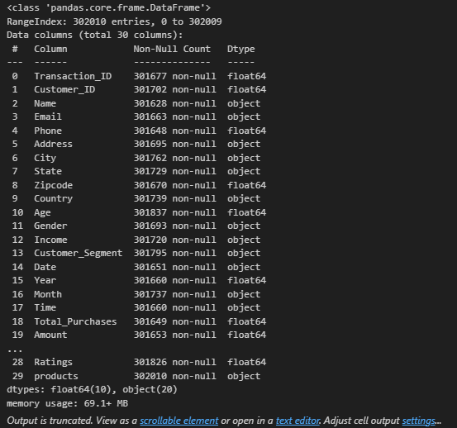
EDA on retail sales data
info

Slide 8
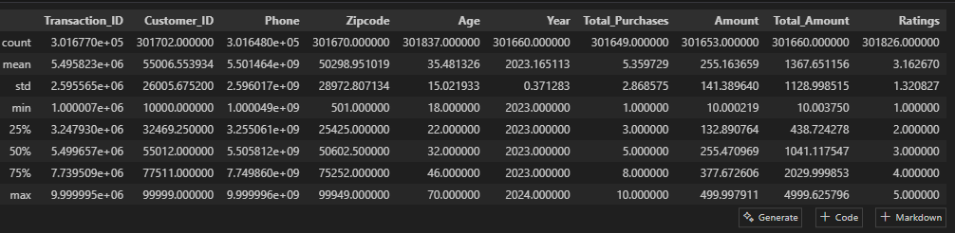
EDA on retail sales data
Description-

Slide 9
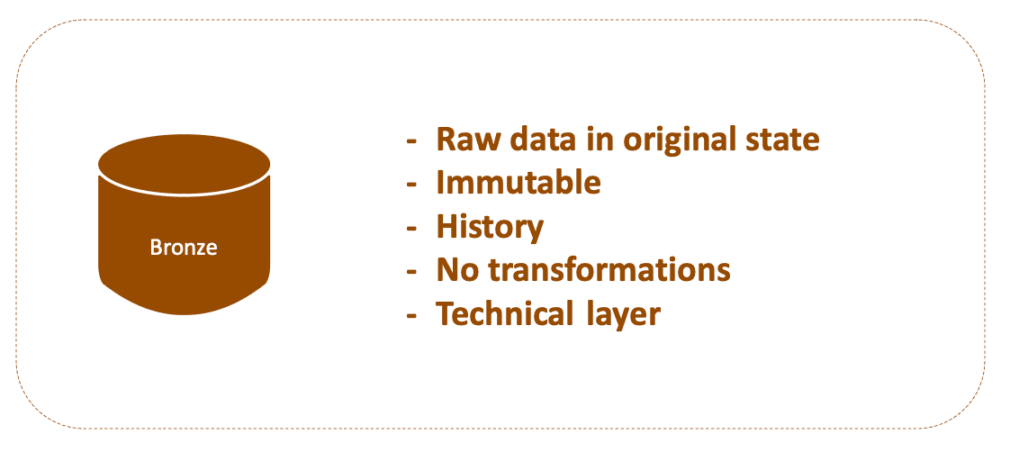
Bronze Layer
Challenges Incurred during retail sales data analysis bronze stage-
1)Choosing an appropriate datatype for each column
2)Choosing lengths for all string type columns
The primary error was handling the encoding error.
The encoding of the characters was of the type ‘utf-8’
Encountered error:
Msg 4864, Level 16, State 1, Line 1 Bulk load data conversion error (type mismatch or invalid character for the specified codepage) for row 1, column 1 (TRANSACTION_ID).
Caused due to
BULK INSERT BRONZE.RETAIL_SALES_DETAILS
FROM 'C:\Data\retail_sales.csv'
WITH (
FIRSTROW = 2,
FIELDTERMINATOR = ',',
ROWTERMINATOR = '\n',
TABLOCK
);

Slide 10
Bronze Layer
The error was fixed by
BULK INSERT BRONZE.RETAIL_SALES_DETAILS
FROM "C:\Users\vishw\OneDrive\Desktop\projects\EYproject\retail_data.csv"
WITH(
FIRSTROW=2,
FORMAT='CSV',
FIELDTERMINATOR=',',
ROWTERMINATOR='\n',
CODEPAGE = '65001',
TABLOCK
);
SELECT * FROM BRONZE.RETAIL_SALES_DETAILS;

Slide 11
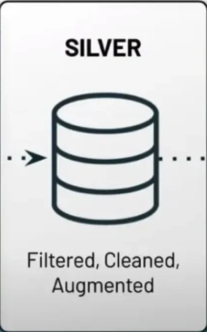
Silver layer
Challenges encountered:
Dealing with various NULL values in EVERY COLUMN
Replaced NULL with N/A in places where data could not be effectively replaced. Examples include CUST_PHONE,CUST_ZIPCODE,where data cannot be replaced without consulting sources.
Biggest issue with NULLS-Primary key
TRANSACTION_ID AND CUST_ID act as primary keys for two tables
This means they cannot be null or have duplicates

Slide 12
Silver layer
In order to fix the duplicate issues with the primary keys,we order them by transaction date and select the latest date.
WITH LatestPerTransaction AS (
SELECT *,
ROW_NUMBER() OVER (PARTITION BY TRANSACTION_ID ORDER BY TRANSACTION_DATE DESC) AS RN_Trans
FROM BRONZE.RETAIL_SALES_DETAILS
),
FilteredTransaction AS (
SELECT * FROM LatestPerTransaction WHERE RN_Trans = 1
),
LatestPerCustomer AS (
SELECT *,
ROW_NUMBER() OVER (PARTITION BY CUST_ID ORDER BY TRANSACTION_DATE DESC) AS RN_Cust
FROM FilteredTransaction
),
FilteredCustomer AS (
SELECT * FROM LatestPerCustomer WHERE RN_Cust = 1
)

Slide 13
Silver Layer
In order to fix the NULL values in the primary keys-
We assign CUST_ID to TRANSACTION_ID when TRANSACTION_ID IS NULL and vice versa
Next special case of NULL Values is the transaction dates.
In the table , transaction month and year are mentioned , but some dates are NULL.
Therefore, we build the transaction date using the available data.
Another important transformation done is TRANSACTION_TIME
The time format is converted to TIME(0)
Another transformation done is performed on floating point values.
The floating point values were rounded off to 2 decimal places.

Slide 14
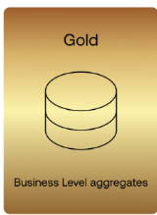
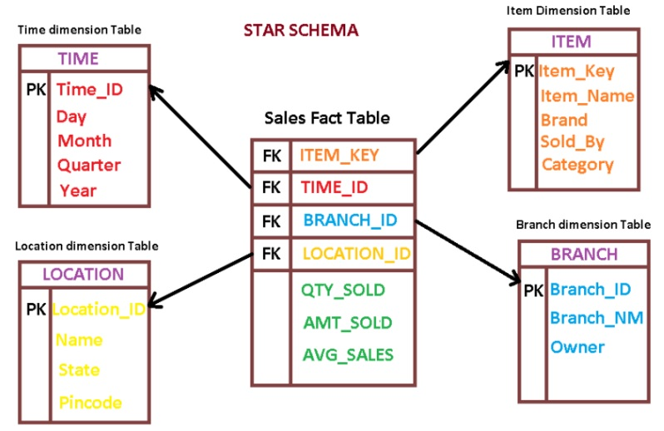
Gold Layer
In the gold layer we create Dimension and Facts
GOLD.DIM_CUSTOMER,GOLD.DIM_PRODUCT AND GOLD.FACT_SALES
We create foreign keys to link tables
CUSTOMER_ID INT FOREIGN KEY REFERENCES GOLD.DIM_CUSTOMER(CUSTOMER_ID),
PRODUCT_ID INT FOREIGN KEY REFERENCES GOLD.DIM_PRODUCT(PRODUCT_ID),
Example of a STAR schema

Slide 15
Gold Layer
We create FACT_SALES USING dimension of customer and product.
We insert data from SILVER tables.
We join the tables using these parameters
JOIN GOLD.DIM_CUSTOMER C
ON S.CUST_ID = C.CUSTOMER_ID
JOIN GOLD.DIM_PRODUCT P
ON S.PRODUCT_CAT = P.PRODUCT_CAT
AND S.PRODUCT_BRAND = P.PRODUCT_BRAND
AND S.PRODUCT_TYPE = P.PRODUCT_TYPE
AND S.PRODUCT_FEEDBACK = P.PRODUCT_FEEDBACK
AND S.PRODUCT_SHIPPING = P.PRODUCT_SHIPPING
AND S.PRODUCTS = P.PRODUCTS;

Slide 16
Gold Layer
The Gold Layer in a Medallion Architecture (used in data engineering and modern data warehousing, like in Databricks or traditional SQL systems) refers to the final, most refined layer of data.
The Gold Layer is used for business reporting and analytics. It:
Contains aggregated, enriched, or denormalized data.
Is designed for direct consumption by BI tools like Power BI, Tableau, etc.
Typically consists of Fact and Dimension tables in a Star Schema or Snowflake Schema.

Slide 17
PowerBI
Power BI is a business analytics tool developed by Microsoft that allows you to:
Create interactive dashboards, charts, and reports
Drag-and-drop interface for easy visual storytelling
Supports various visuals: bar charts, maps, KPIs, tables, etc.
The creation of a three page PowerBI Report is done.

